Slide 1
20XC15 -Problem Solving and C Programming

Slide 2
Outline
Course Introduction
Text and Reference Books
What is a Computer?
Advantages of using computers
Hardware & Software
Types of Softwares
Computer Architecture
Computer Organization
Programming

Slide 3
Course Introduction
Introduces novices to programming – using the C Programming Language
Aims to teach how to solve problems using the computer
Every discipline uses computing : All branches of Engineering, Science, design and arts
No prior exposure to programming is needed

Slide 4
Text and Reference Books
TEXT BOOKS
  Brian W. Kernighan and Dennis Ritchie, “The C Programming Language”, Pearson Education India, 2015
  R G Dromey, “How to solve it by computer”, Pearson 2008
REFERENCES
  Herbert Schildt, “C The Complete Reference", McGraw Hill, 2017
  Gottfried B, “Programming With C”, McGraw Hill, 2011
  Peter Prinz and Tony Crawford, “C in a Nutshell”, O′Reilly, 2016

Slide 5
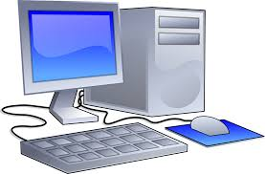
What is a Computer?
A computer is a device that can perform computations and make logical decisions billions of times faster than human beings can
  Input : User gives a set of Input
  Processing : Input data is processed by a well defined and finite sequence of steps
  Output : Some data available from processing step and output to the user
Computers process data under the control of sets of instructions called computer programs

Slide 6
Advantages of using Computers
Speed
  Many computers process billions or trillions of operations in a single second
Accuracy
  If input data and procedures are correct, the output will be consistently accurate
Reliability
  The electronic components in modern computers are dependable and reliable because they rarely break or fail
Consistency
  Given the same input and processes, a computer will produce the same results - consistently
Storage
  Computers store enormous amounts of data and make this data available for processing anytime it is needed
Communications
  Computers allow users to communicate with one another

Slide 7
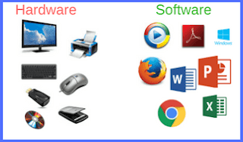
Hardware & Software
Hardware
  Various devices comprising a computer
    Keyboard, screen, mouse, disks, memory, CD-ROM, and processing units
Software
  Programs that run on a computer
    Notepad, MS Word, etc.

Slide 8
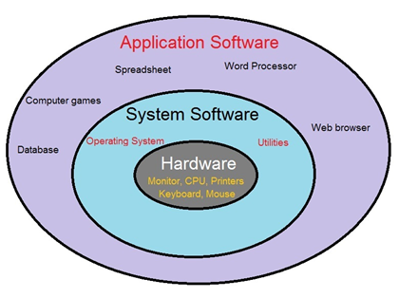
Types of Software
Application Software
  Programs that perform specific tasks for users
  Examples
    Word Processors
    Databases
    Spread Sheets
    Internet Browsers
System Software
  Programs that control or maintain the operations of the computer and its devices
  Provides a platform to install, develop and run application softwares
  Examples
    Operating Systems
    Compilers
    Loader and Linkers
    Device Drivers
    Utility Programs

Slide 9
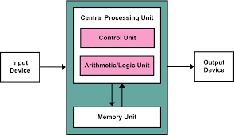
Computer Architecture

Slide 10
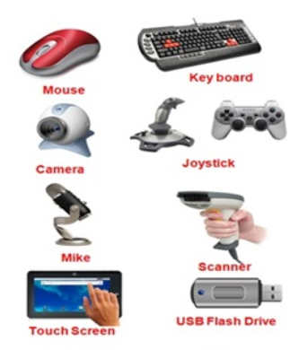
Computer Organization
The different components in a computer architecture:
Input unit
    Hardware used to enter
    data and instructions

Slide 11
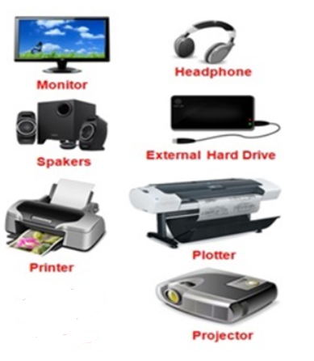
Computer Organization
Output unit
    Hardware that conveys information
    to one or more people

Slide 12
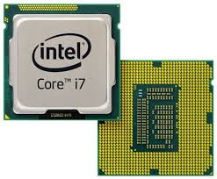
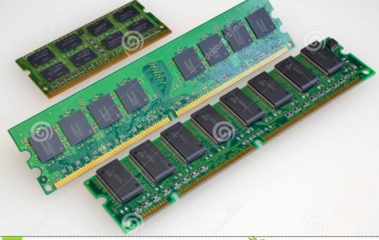
Computer Organization
Central processing unit (CPU)
  Also called Processor - Heart of the computer
  CPU consists of
    Arithmetic and logic unit (ALU)
      Performs arithmetic calculations and logic decisions
    Control unit
      Directs most operations by providing timing and control signals
    Memory unit
      Rapid access, low capacity, stores input information, making it immediately available for processing when needed - Information in the memory unit is volatile

Slide 13

Computer Organization
1 Bit = Binary Digit
4 bits = 1 Nibble
8 Bits = 1 Byte
1024 Bytes = 1 Kilobyte
1024 Kilobytes = 1 Megabyte
1024 Megabytes = 1 Gigabyte
1024 Gigabytes = 1 Terabyte
1024 Terabytes = 1 Petabyte
1024 Petabytes = 1 Exabyte
1024 Exabytes = 1 Zettabyte
1024 Zettabytes = 1 Yottabyte
1024 Yottabytes = 1 Brontobyte
1024 Brontobytes = 1 Geopbyte
Byte - a unit of storage measurement in computers, regardless of the type of data being stored

Slide 14
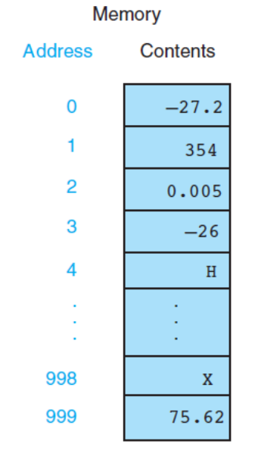
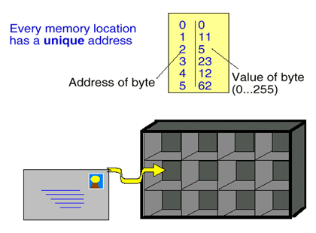
Computer Organization
Memory is divided into an array of "boxes" each
containing a byte of information.
  A byte consists of 8 bits
  A bit (binary digit) is either 0 (OFF) or 1 (ON).
  The memory unit also serves as a storage for intermediate
  and final results of arithmetic operations
Secondary storage unit
  Cheap, long-term, high-capacity storage
  Stores inactive programs
  Information on secondary storage
    devices - persistent

Slide 15
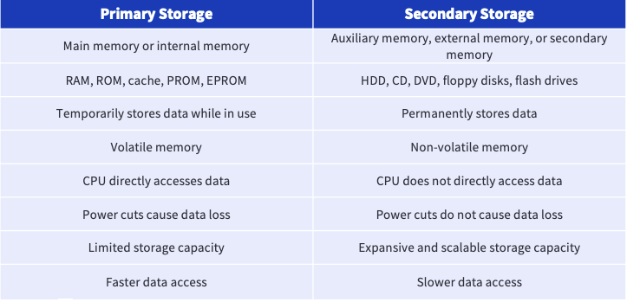
Types of Memory
RAM -
RAM -

Slide 16
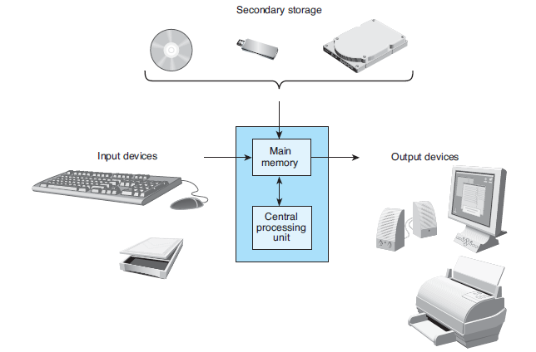
Components of a Computer

Slide 17
Programming and Software
Computer needs to be programmed to do specific tasks
Programming
  Process of writing instructions in a language that can be understood by the computer so that a desired task can be performed by it
Program
  Sequence of instructions to do a task, computer processes the instructions sequentially one after the other
Software
  A set of programs for doing tasks on computers

Slide 18
Retention Questions
What is a computer?
Hardware Vs Software
Types of softwares
Six Logical units of a computer
Primary Vs Secondary memory
What is Programming?

